Slide 1
Français Langue Seconde (FSL 2020-2021 )
Mme Alana (cycle 1 and 2)
Mme Joyce Haddad (KDg and Cycle 2)
Mme Dragomir (Cycle 2 and 3)
Mme Bourque (cycle 2 and 3)

Slide 2
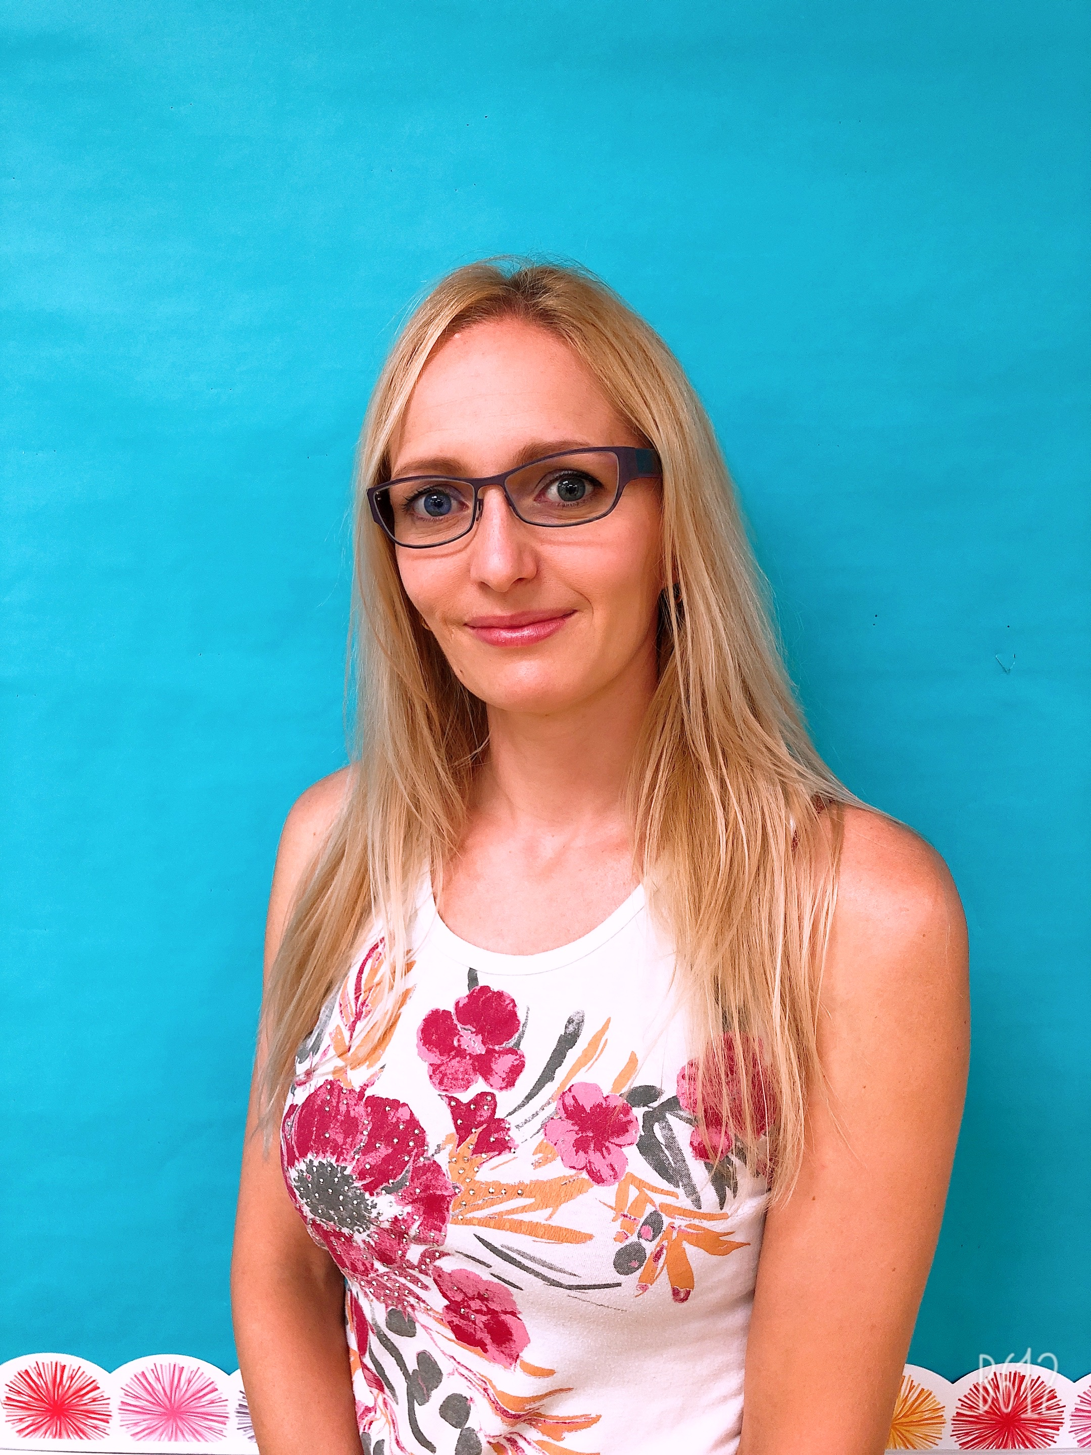
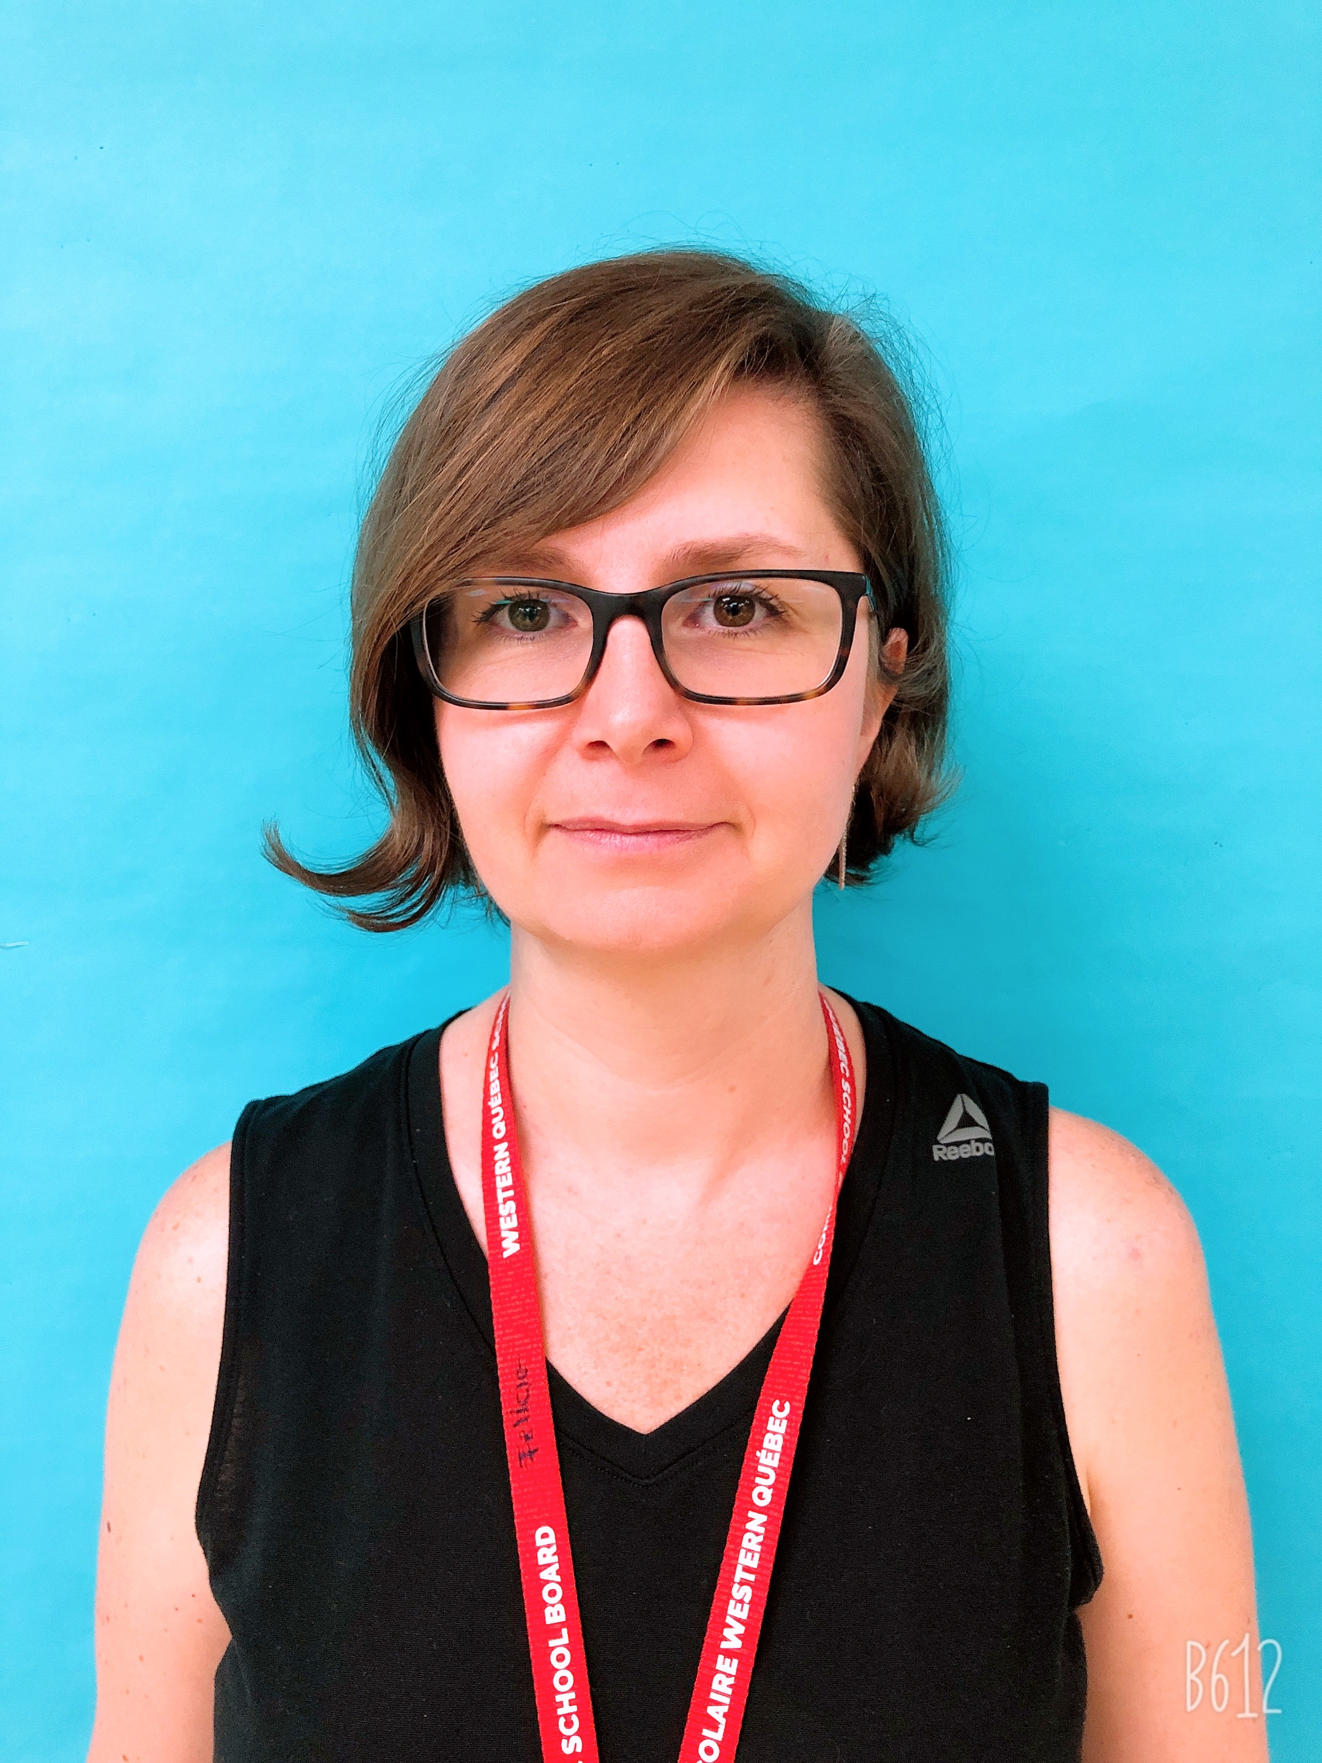
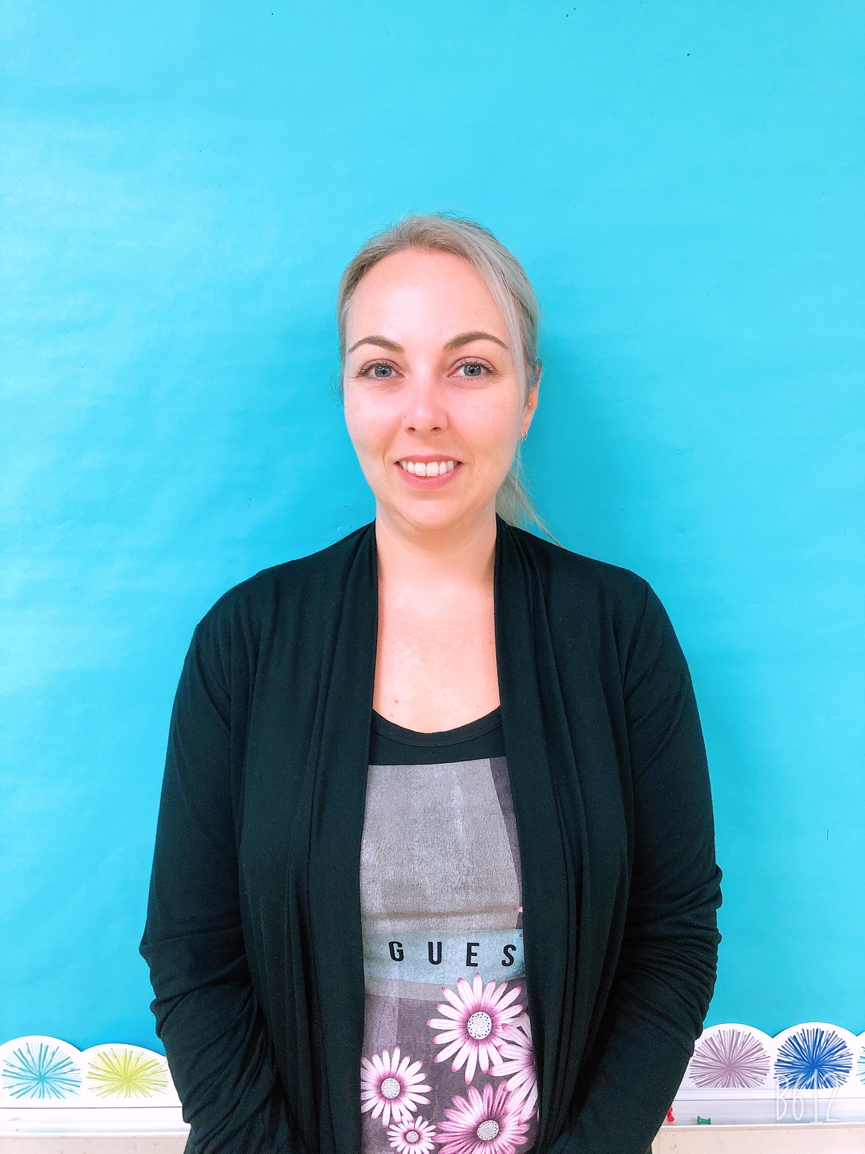
WELCOME TO THE FRENCH PROGRAM AT GREATER GATINEAU 2020-2021 Meet the FSL teachers
Mme Alana
Ms. Carrey (Gr. 1 core FSL)
Ms. Sanford (Gr. 1 enriched FSL)
Ms. Hooker (Gr. 1/2 core FSL)
Ms. Given (Gr. 2 core and
enriched FSL)
Mr. McClelland (Gr. 2/3 enriched
FSL)
Mme Joyce
Ms. Bush (Kindergarten)
Ms. D-V (Gr. 3 core FSL)
Ms. Weir (Gr. 3 core and
enriched FSL)
Ms. Schindel (Gr. 3/4 enriched
FSL)
Mme Dragomir
Ms. Cuzin (Gr. 4/5 Enriched FSL)
Mr. Everson (Gr.5 Enriched FSL)
Mr. Birch (Gr.6 Core and Enriched,
FSL and Science)
Ms. Sauvé (Gr. 6 Enriched FSl and
Science)
Mme Bourque
Ms. Plue (Gr. 4 core FSL)
Ms. Stone (Gr.5 core FSL)
Mr. Schultz (Gr. 5 core FSL)
Ms. Fama (Gr. 6 core FSL)
Mr. Dooling (Gr. 6 core FSL)

Slide 3
Suggestions for French Books and activities online
Given the unprecedented circumstances, this school year will be an exceptional one; therefore, there will be no French homework assigned. However, we strongly encourage your child to read daily in French. Suggestions on following slide.

Slide 4
KDg- Cycle 1
https://educharlevoix.ca/bibliotheque/categories/livre-audio-niveau-1-familiarisation/
https://www.ednet.ns.ca/ensemblecheznous/
https://litterature-jeunesse-libre.fr/bbs/
https://www.iletaitunehistoire.com/
https://literacy.concordia.ca/abra/fr/
Cycle 2 – 3
https://www.successcolaire.ca/la-classe-en-ligne/
https://ici.radio-canada.ca/premiere/enfants-et-famille
https://podcasts.apple.com/fr/podcast/petits-curieux/id1444819061
https://educapp.org/
https://www.logicieleducatif.fr/index_lecture.php
https://www.alloprof.qc.ca/fr/eleves/bv/francais
https://www.lasouris-web.org/index.html

